Slide 1


Getting Ready for Y6 -
Parents Workshop
Wednesday 5th June 2024

Slide 2




At home designate a quiet space, away from distractions, where you child does their weekly homework tasks. Make sure your child has pens, pencils and paper readily available. In Y6, weekly homework is set - on line and written tasks.
Help your child plan and stick to a homework timetable that fits in with their life outside of school.
Research says that a little homework learning every night helps children learn more and remember more.
Study Habits
Y6 Weekly Homework:
Learning 20 spelling in preparation for the weekly spelling test. Pass mark is 15/20.
Times Tables Practise. To access the maths curriculum in Y6, children must have effective recall of all times tables facts. Play one game on TTRS every evening.
Sats Companion. A maths and an English task is set on here every week.
SPAG – written homework in a workbook, which we will provide for your children.
Reading: your child will be expected to read a book of their choice for pleasure at home each day. Research suggests 20 minutes reading each evening for Y6 children.

Slide 3
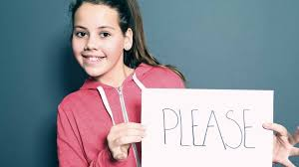
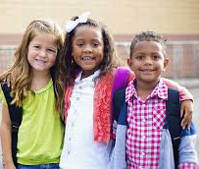
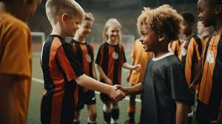
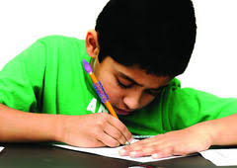


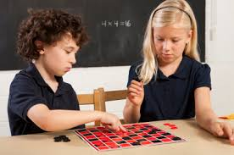
Being Socially and Emotionally Ready for Y6
Social Readiness:
Share
Take turns
Communicate their feelings respectfully
Listen to other peoples’ point of view
Use their manners
Be respectful
Be able to participate in class discussions.
Emotional Readiness
Being able to persevere with a task.
Control and take responsibility for their own behaviour.
The desire to be a successful learner.
Be able to build and maintain healthy friendships with their peers.

Slide 4

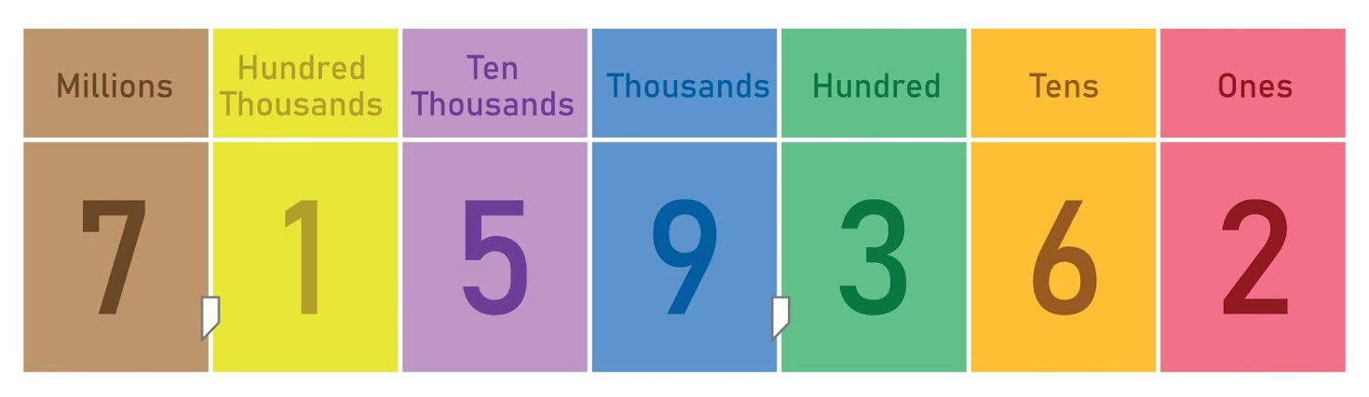
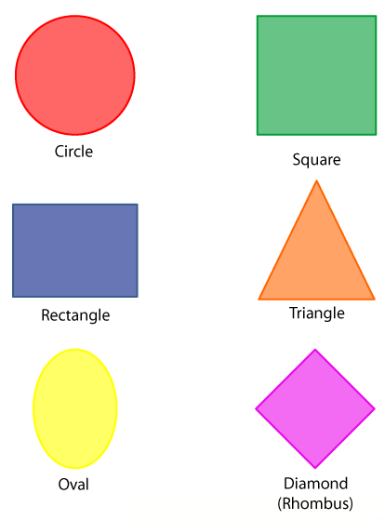

Academic Readiness for Y6
Maths
To be successful in maths in Y6, your child needs to:
Know four rules of number (addition, subtraction, multiplication and division.
Understand place Value (know what the value of each digit is in a number).
Know the names and properties of basic shapes
Know their times tables well.
Be able to tell the time using analogue and digital clock.
Understand basic fractions.
Now let's try some maths…

Slide 5
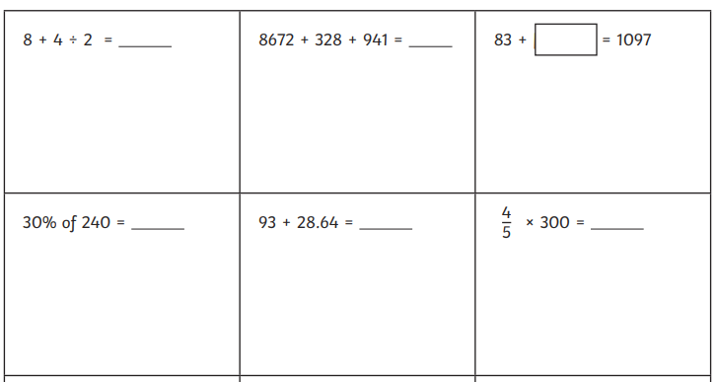

Slide 6
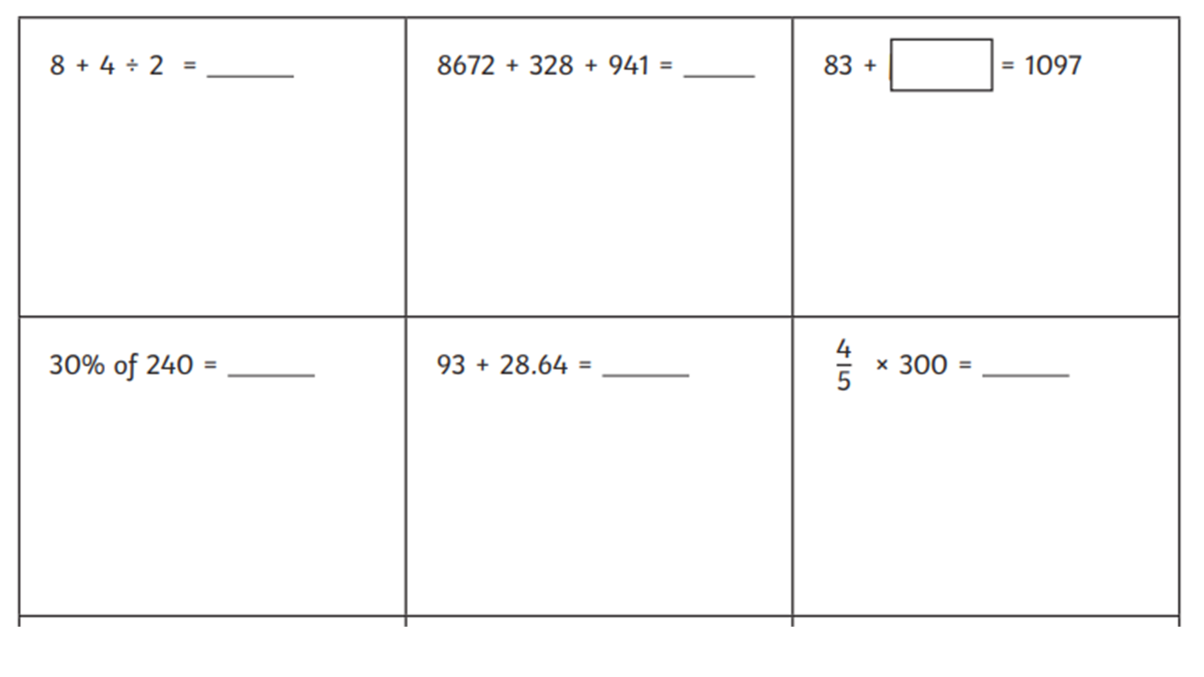
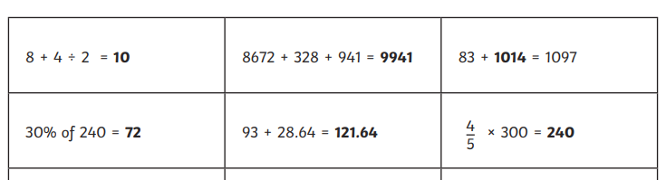
Answers
1097
83
?
BIDMAS
Explore different strategies.
Represent and inverse
Understanding of percentages.
Understanding of place value.
Understanding of fractions.

Slide 7
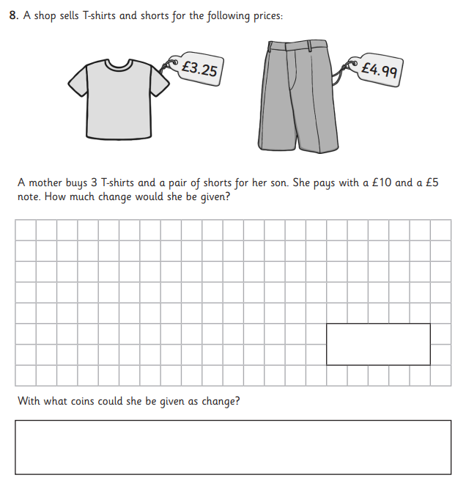
Reasoning: Real world maths
Draw a bar model to represent this problem.

Slide 8


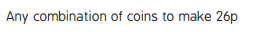
Draw a bar model to represent this problem.
£15
T shirt
T shirt
shorts
change
3 x £3.25 = £9.75
£9.75 + £4.99 = £14.74
£15 - £14.74 = 26p
26p

Slide 9


Academic Readiness for Y6
English - Reading
To be successful in reading in Y6, your child needs to:
Be able to read an age-appropriate text fluently and accurately – this equates to 194 word per minute.
To be able to answer questions about the text: retrieval and inference.

Slide 10
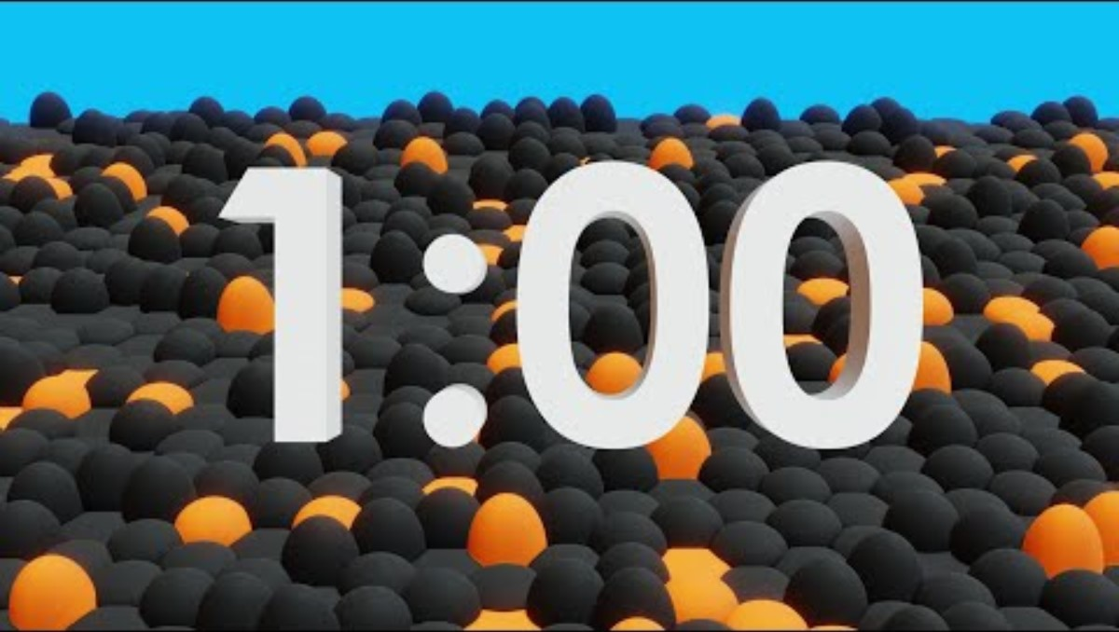
Please refer to your Year 6 WCPM text.
1 minute timer

Slide 11
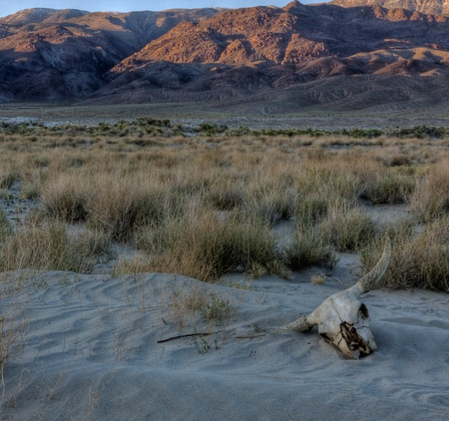
Getting Inside a Writer’s Head
4
Day
Reading Focus – 2g: Identify/explain how meaning is enhanced through choice of words and phrases.
As I stagger further into the seemingly never-ending landscape of sand, the torrid heat is now taking its toll. All around me, dehydrated plants are begging for the smallest drop of moisture. With my own water canteen almost dry and an insatiable thirst, I wonder how long it will be before this dusty canyon claims its next victim?
Which words and phrases show that the narrator of the passage is in a desperate situation?
Look for an example of personification. How does this
enhance meaning?
Why does the author finish the passage with a rhetorical question?

Slide 12
Getting Inside a Writer’s Head Answers
4
Day
Reading Focus – 2g: Identify/explain how meaning is enhanced through choice of words and phrases.
As I stagger further into the seemingly never-ending landscape of sand, the torrid heat is now taking its toll. All around me, dehydrated plants are begging for the smallest drop of moisture. With my own water canteen almost dry and an insatiable thirst, I wonder how long it will be before this dusty canyon claims its next victim?
As I stagger further into the seemingly never-ending landscape of sand, the torrid heat is now taking its toll. All around me, dehydrated plants are begging for the smallest drop of moisture. With my own water canteen almost dry and an insatiable thirst, I wonder how long it will be before this dusty canyon claims its next victim?
Which words and phrases show that the narrator of the passage is in a desperate situation?
The narrator is ‘staggering’ and the heat is getting too much. The text gives you the impression that they are lost. Their water has almost run out and they are starting to fear for their life when they say that they may be the desert’s ‘next victim’. You know that people have perished there before.

Slide 13
Getting Inside a Writer’s Head Answers
4
Day
Reading Focus – 2g: Identify/explain how meaning is enhanced through choice of words and phrases.
As I stagger further into the seemingly never-ending landscape of sand, the torrid heat is now taking its toll. All around me, dehydrated plants are begging for the smallest drop of moisture. With my own water canteen almost dry and an insatiable thirst, I wonder how long it will be before this dusty canyon claims its next victim?
As I stagger further into the seemingly never-ending landscape of sand, the torrid heat is now taking its toll. All around me, dehydrated plants are begging for the smallest drop of moisture. With my own water canteen almost dry and an insatiable thirst, I wonder how long it will be before this dusty canyon claims its next victim?
Look for an example of personification. How does this enhance meaning?
The author uses personification when they say that the plants are ‘begging’ for water. It makes it clear that the plants are also struggling to survive in this harsh, unforgiving environment.

Slide 14
Getting Inside a Writer’s Head Answers
4
Day
Reading Focus – 2g: Identify/explain how meaning is enhanced through choice of words and phrases.
As I stagger further into the seemingly never-ending landscape of sand, the torrid heat is now taking its toll. All around me, dehydrated plants are begging for the smallest drop of moisture. With my own water canteen almost dry and an insatiable thirst, I wonder how long it will be before this dusty canyon claims its next victim?
As I stagger further into the seemingly never-ending landscape of sand, the torrid heat is now taking its toll. All around me, dehydrated plants are begging for the smallest drop of moisture. With my own water canteen almost dry and an insatiable thirst, I wonder how long it will be before this dusty canyon claims its next victim?
Why does the author finish the passage with a rhetorical question?
The rhetorical question leaves you wondering and fearing the worst for the narrator of the passage.

Slide 15
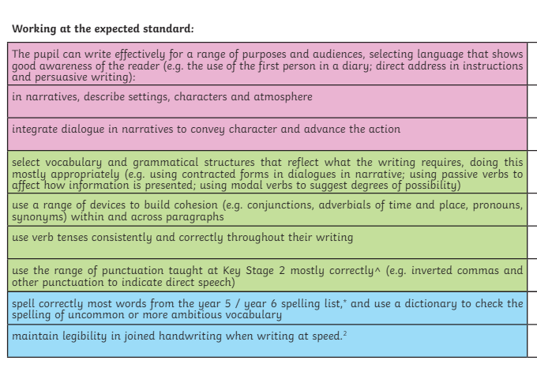
Academic Readiness for Y6
English - Writing
To be successful in writing in Y6, your child needs to:
Practise spellings
Practise writing for different purposes, using punctuation correctly.

Slide 16

Synonym & Antonym Compasses
3
Day
Vocabulary Focus – G6.1: How words are related by meaning as synonyms and antonyms
Look at this completed synonym and antonym compass:
Now, complete this compass. If you need to, use a thesaurus for support.
honest
polite
truthful
deceitful
devious
Use one of your synonym or antonym words
in a sentence with a question tag.

Slide 17
Synonym & Antonym Compasses Answers
3
Day
Vocabulary Focus – G6.1: How words are related by meaning as synonyms and antonyms
Possible answers could be:
polite
well-mannered
vulgar
discourteous
Did you think of a sentence with a question tag?
For example: You are always well-mannered at school, aren’t you?

Slide 18
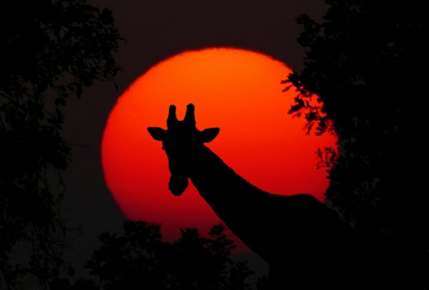
Think and Write
5
Day
Punctuation, Grammar and Vocabulary Focus – Mixed Skills
Click to view image full screen
Use this photograph as your inspiration to think and write using the following pattern of sentences:
Sentence 1
Must contain a fronted adverbial.
Sentence 2
Must include a simile.
Sentence 3
Needs to include a possessive apostrophe.
Sentence 4
Must be in the passive voice.
Sentence 5
Needs to be a question sentence.
Read through your passage carefully – does it include everything we are looking for?

Slide 19
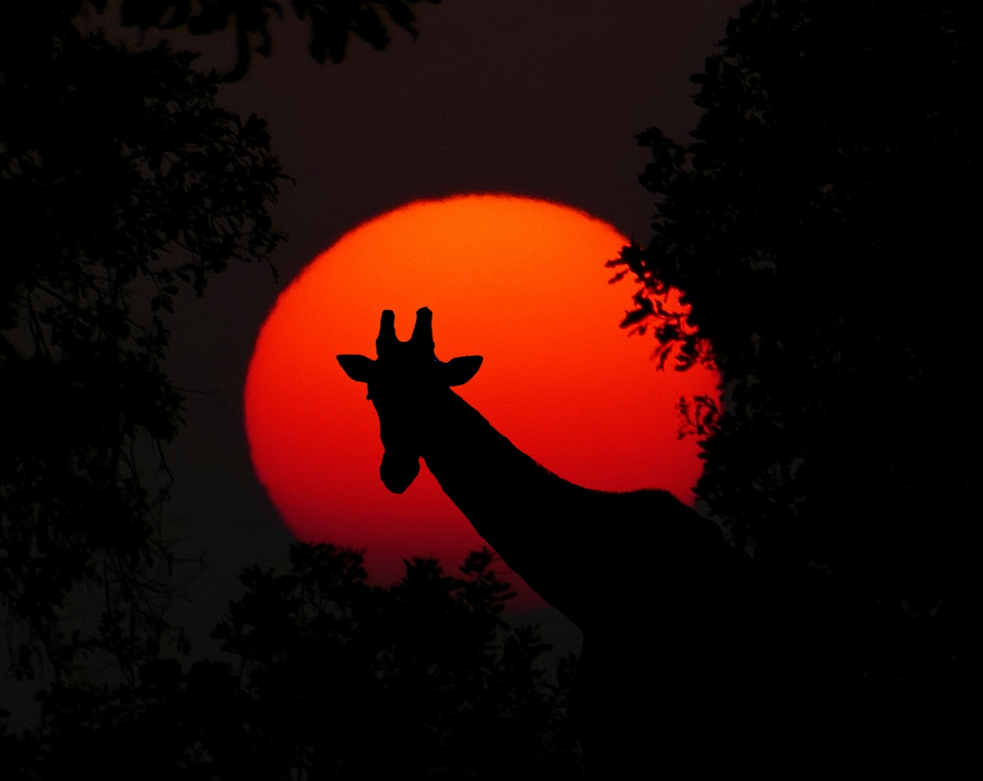

5
Day

Slide 20

Think and Write Example Answers
5
Day
Punctuation, Grammar and Vocabulary Focus – Mixed Skills
Here’s an example of what you could have thought and written…
Deep in the African savannah, day was quickly becoming night.
fronted adverbial
The setting sun was glistening like a radiant ruby in the darkening sky.
simile
Slowly and deliberately, the giraffe’s towering silhouette passed across the landscape.
possessive apostrophe
The leaves on the nearby trees were being nibbled as she passed.
Passive voice
Would you like to experience an African safari?
question sentence

Slide 21
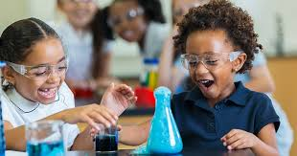
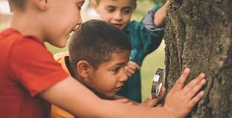
Academic Readiness for Y6
Science
To be successful in science in Y6, your child needs to:
Have a basic understanding of scientific concepts studied so far.
Be able to conduct simple experiments.
Know that results need to be accurate and use them to prove or disprove a theory.
Let’s try some Y6 science questions…

Slide 22
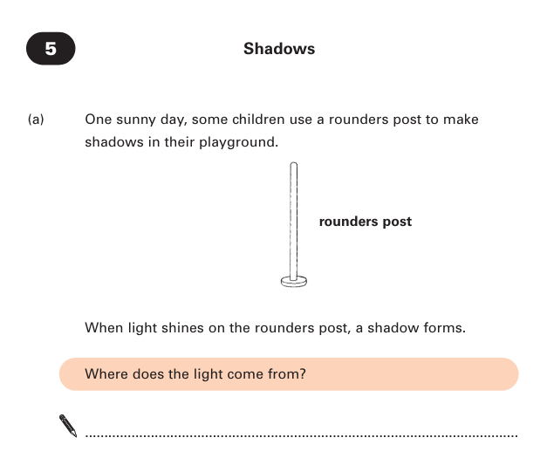
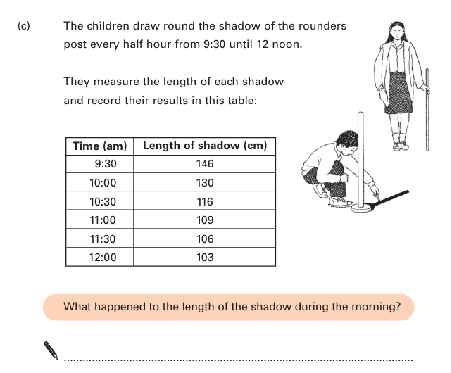
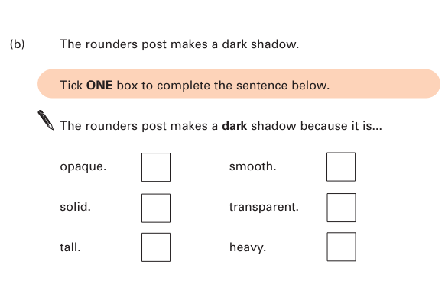

Slide 23
Sun or sunlight
The shadow got shorter.

Slide 24
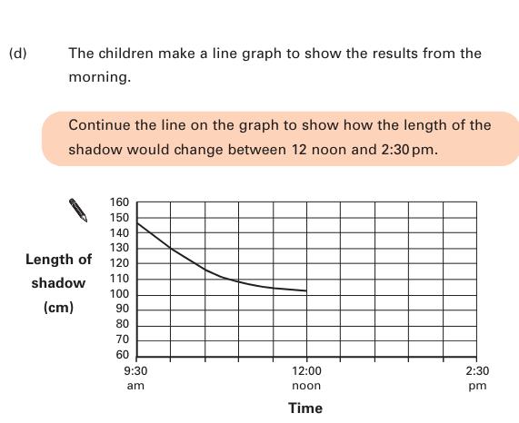

Slide 25
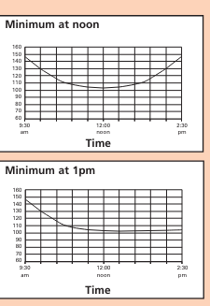

Slide 26

The Ready For Y6 Summer Holiday Project
The aim of the project is for your child to think about what they would like to do in the future and identify the skills and attitudes they need to develop to make it a reality. Research says that young people need a combination of aspiration, knowledge and attainment to fulfil their ambitions.
The Research…
Finally, ambition helps children to recover from setbacks and failures. It fosters resilience by instilling the belief that setbacks are temporary and provide growth opportunities.
Nurturing ambition typically equips children with the determination to learn from failures, adapt, and persevere.
Ambitious individuals exhibit a sense of purpose, pushing them to take initiative and strive for excellence. Nurturing ambition can empower children to develop self-motivation, enabling them to overcome obstacles and remain focused on their aspirations.
By encouraging goal-setting behaviours, you help you child build a foundation of determination and resilience that will serve them in various aspects of life.

Slide 27

Professional Gamer - Qualifications
If you plan to be a video game streamer and have a presence on social media, you’ll need good communication and writing skills. Take English, speech, and writing classes to develop these skills.
If you want to become a gamer to learn more about software and game design, pursuing higher education may be beneficial. Depending on your career goals, it might be useful to pursue a degree in marketing, software design, computer science or video game development. An undergraduate degree is usually a requirement for professional positions.

Slide 28
Professional Gamer Skills
Strategic thinking. Being strategic with your gaming can even be more important than being faster. This type of skill requires the gamer to think ahead and make quick decisions on how to win in any type of situation.
Quick reflexes. Most online games are very fast-paced. Having quick reflexes is essential, as even a one-second delay can mean the difference between winning or losing a game.
Calmness. Professional gamers often place themselves in very stressful situations. Being calm during these moments is crucial for making the right decisions to win the game.
Discipline. To become a professional gamer, you spend several hours practising and competing. To maintain this type of work ethic, discipline is essential to keep you focused throughout the entire process.
Teamwork. Being a team player can enable you to work well within your team and help you win competitions. This requires communication skills, being adaptable, and being reliable by arriving on time to events.
Criticism. You must be able to take criticism and learn from your mistakes.

Slide 29

Cultivating a Growth Mindset…
Instil a love of learning to foster curiosity and ambition in your child. Promote a desire for knowledge. Show that you value education. Help your child to understand that success comes from pure hard work. Value their effort, resilience and perseverance. Encourage your child to embrace challenge.

Slide 30

Attendance and Punctuality
Being in school is important to your child’s achievement, wellbeing, and wider development. Evidence shows that the students with the highest attendance are more likely to achieve the expected standard at the end of primary school and gain the best GCSE and A Level results.
DFE research found that pupils who performed better both at the end of primary school and the end of secondary school missed fewer days than those who didn’t perform as well.
Learning starts every day at 8.45 in Y6.

